Slide 1
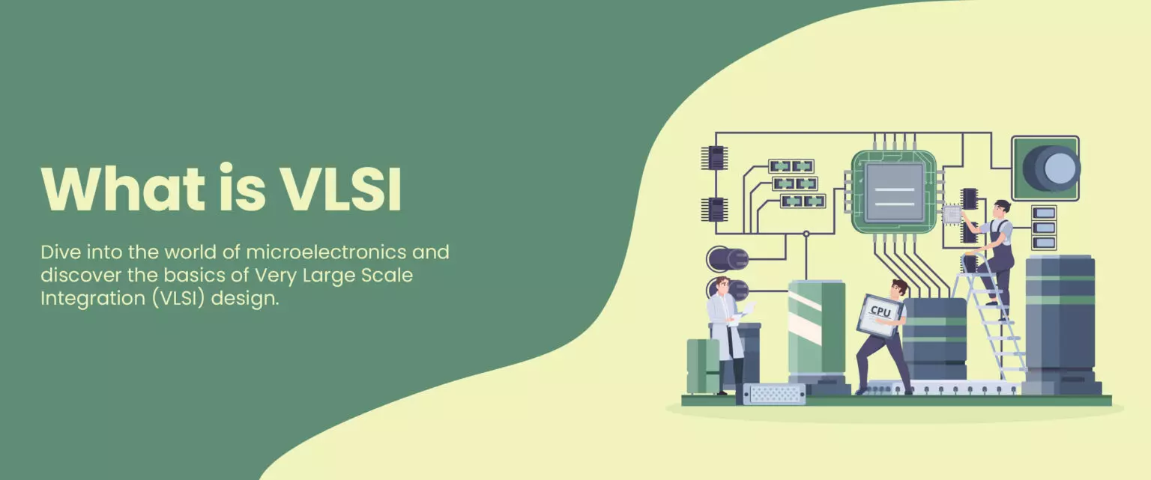
Introduction to VLSI
By- Chandramouli Haldar

Slide 2
VLSI
VLSI stands for Very Large Scale Integration. It is the process of producing integrated circuits (ICs) by integrating thousands, millions, or even billions of transistors on a single chip.
The integrated circuits ICs are used in VLSI as a broad range of devices, from fundamental devices to advanced supercomputers.
VLSI technology enables the integration of complete systems such as processors, memory, and logic circuits onto a single chip.
It is the backbone of modern electronics, powering devices like smartphones, laptops, communication systems, and embedded systems.

Slide 3
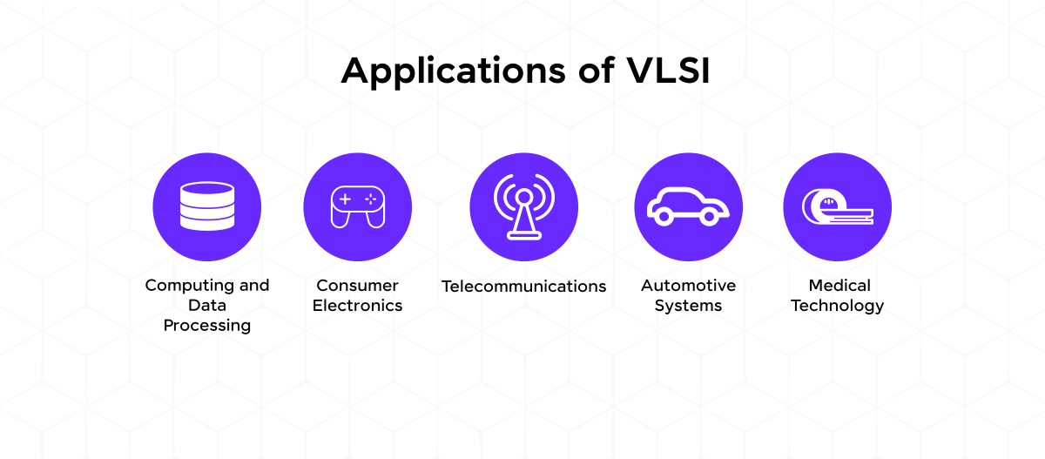

Slide 4
Types of Integrations
Integration Level | Transistors per Chip | Era | Examples
Small Scale Integration (SSI) | < 100 | 1960s | Basic logic gates
Medium Scale Integration (MSI) | 100–1,000 | Early 1970s | Counters, adders
Large Scale Integration (LSI) | 1,000–10,000 | Mid 1970s | Early microprocessors
Very Large Scale Integration (VLSI) | 100,000–1,000,000+ | 1980s onward | 16-bit/32-bit CPUs
Ultra Large Scale Integration (ULSI) | Millions–billions | 2000s–Present | Advanced System-on-Chip (SoC)

Slide 5
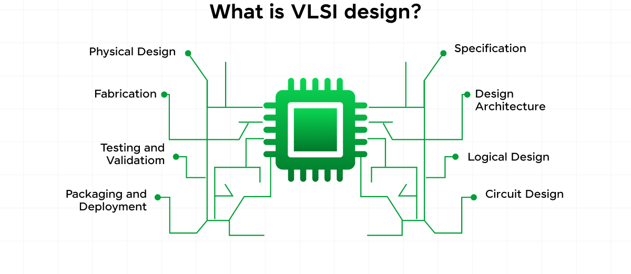

Slide 6
How VLSI Works?
VLSI works by integrating a very large number of transistors onto a single silicon chip using advanced semiconductor fabrication technology.
Transistors in VLSI act as tiny electronic switches that control the flow of electrical signals (0 and 1).
Using CMOS technology (nMOS and pMOS), these transistors are arranged to form logic gates such as AND, OR, NOT, NAND, etc.

Slide 7
How VLSI Works?
These logic gates are interconnected using metal layers to build complex digital circuits like adders, registers, memory, and processors.
The circuit design is first created using Hardware Description Languages (HDL) such as Verilog or VHDL.
Finally, the design is manufactured on a silicon wafer using photolithography and fabrication processes to produce the complete integrated circuit (IC).

Slide 8


Slide 9
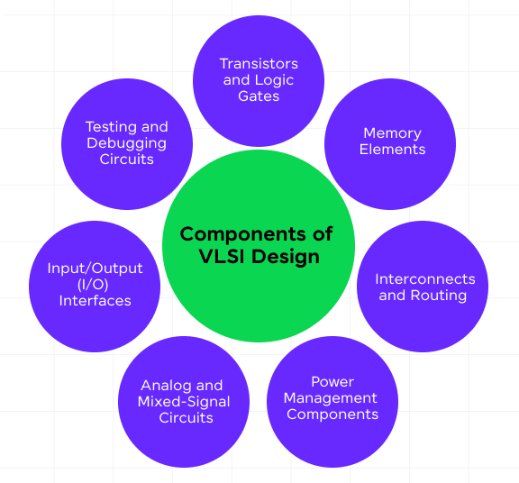

Slide 10
History of VLSI
The history of VLSI began with the invention of the transistor in 1947 at Bell Laboratories, which replaced bulky vacuum tubes.
In 1958, Jack Kilby developed the first integrated circuit (IC), marking the beginning of chip-based electronics.
During the 1960s, Small Scale Integration (SSI) and Medium Scale Integration (MSI) technologies were developed, integrating tens to hundreds of transistors on a chip.
In the 1970s, Large Scale Integration (LSI) enabled thousands of transistors on a single chip, leading to the development of early microprocessors.

Slide 11
History of VLSI
Very Large Scale Integration (VLSI) emerged in the late 1970s and 1980s, allowing hundreds of thousands to millions of transistors to be integrated on one chip.
With continuous scaling and Moore’s Law, VLSI technology advanced to Ultra Large Scale Integration (ULSI), where modern chips now contain billions of transistors.
Today, VLSI technology powers smartphones, computers, AI processors, automotive systems, and advanced supercomputers.

Slide 12
Moore’s Law
Moore’s Law was proposed by Gordon Moore in 1965.
It states that the number of transistors on a chip doubles approximately every 18–24 months.
This leads to continuous improvement in performance and reduction in cost per transistor.
Although scaling is becoming challenging due to physical limits, innovation continues to extend its impact.

Slide 13
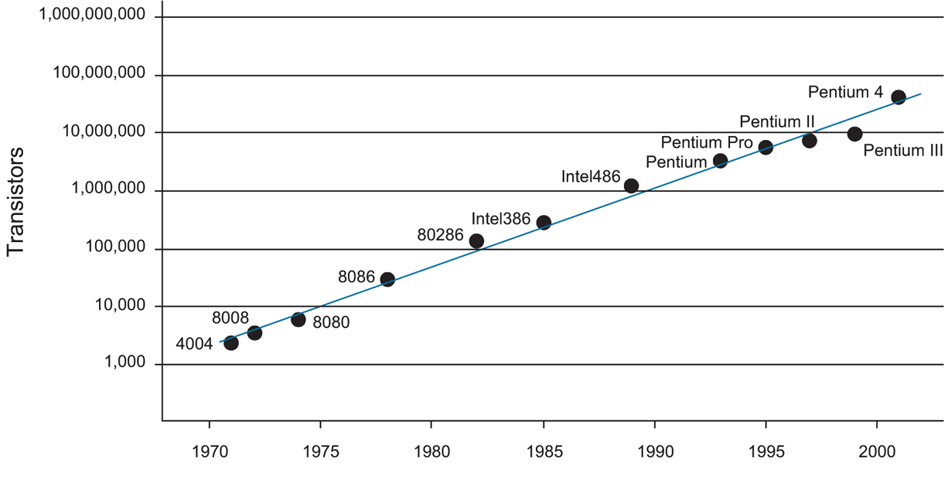
Obligatory historical Moore’s law plot

Slide 14
Advantages of VLSI
Reduces the size of electronic circuits
Increases operating speed
Low power consumption
Lower cost due to mass production
High reliability (fewer external connections)
Better performance and functionality

Slide 15
Disadvantages of VLSI
High initial design and fabrication cost
Complex design and verification process
Requires advanced fabrication technology
Difficult to repair or modify after manufacturing
Heat dissipation and leakage issues in advanced nodes

Slide 16
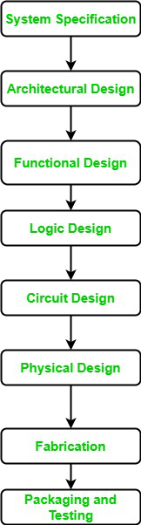
VLSI Design Flow Chart

Slide 17
VLSI Design Flow
System Specification: In this step, we clearly define what the final product should do. We decide its performance, cost, features, and how it will interact with other systems.
Architectural Design: The overall structure of the system is planned. Engineers decide how different blocks (memory, processor, communication, power) will be connected.
Functional / Behavioral Design: The working behavior of the system is described. It explains how the system should respond to inputs and produce outputs.
Logic Design: The system behavior is converted into logic gates and digital circuits. Optimization is done for speed, area, and testability.

Slide 18
VLSI Design Flow
Circuit Design: Logic gates are implemented using real electronic components like transistors. Circuit simulation is performed to check timing and performance.
Physical Design: The actual chip layout is created. All components are placed and connected carefully following design rules.
Fabrication: The final layout is sent for manufacturing (tape-out).The chip is built on a silicon wafer using photolithography.
Packaging and Testing: Working chips are packaged and tested. After final verification, they are delivered to customers.

Slide 19
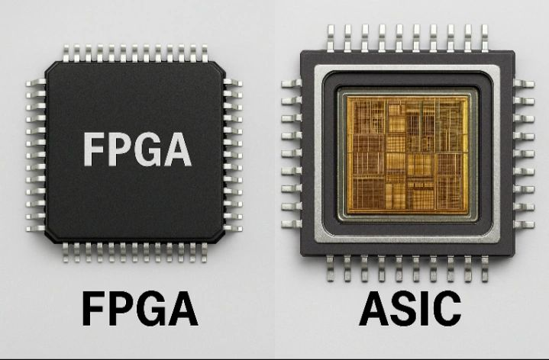
2 main types of VLSI Design

Slide 20
ASIC (Application-Specific Integrated Circuit)
A custom-designed chip made for one specific purpose
Designed using VLSI design flow
Optimized for high speed, low power, and small area
Cannot be changed after manufacturing
Used in smartphones, AI chips, automotive systems
High initial cost, but cheaper for mass production

Slide 21
FPGA (Field-Programmable Gate Array)
A programmable chip that can be configured by the user
Uses HDL (Verilog/VHDL) to program logic
Can be reprogrammed multiple times
Used for prototyping and testing designs
Lower initial cost compared to ASIC
Slightly slower and consumes more power than ASIC

Slide 22
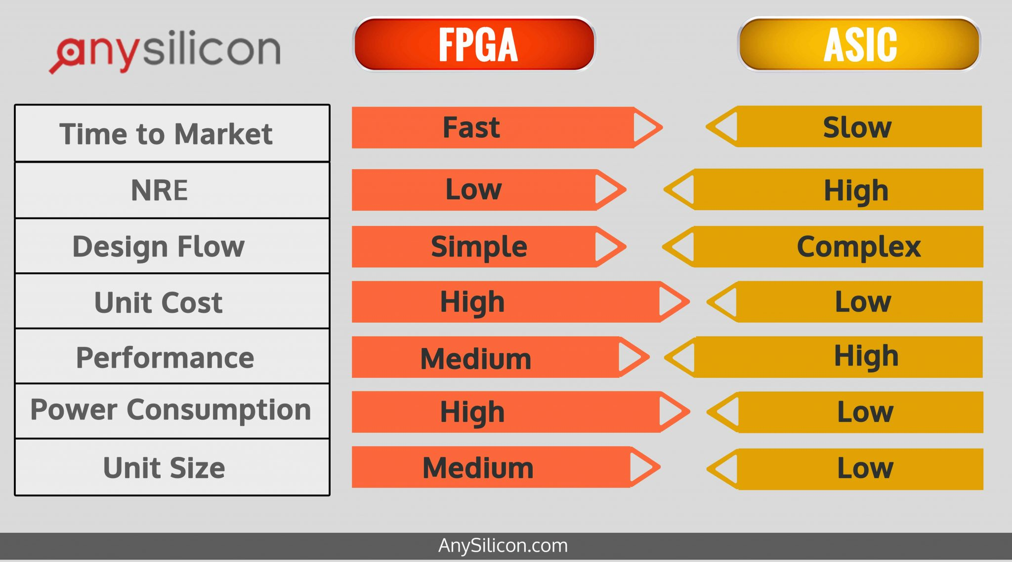

Slide 23
Hardware Description Language (HDL)
HDL is a programming language that is used to describe the structure, behavior and timing of electronic circuits, and most commonly, digital logic circuits.
HDLs are used for designing processors, motherboards, CPUs and various other Digital circuits.
In addition to their use in circuit design, HDLs serve the purpose of simulating the circuit and verifying its response. The most popular HDLs so far are Verilog and VHDL.

Slide 24
VHDL
VHDL stands for Very High-Speed Integrated Circuit Hardware Description Language.
It is used to design and simulate digital circuits.
It has a strict and structured syntax.
Commonly used in defense, aerospace, and academic environments.

Slide 25
Verilog
Verilog is a hardware description language used for digital design.
It has a simpler and C-like syntax.
Widely used in industry for ASIC and FPGA design.
Easier to learn for beginners compared to VHDL.

Slide 26
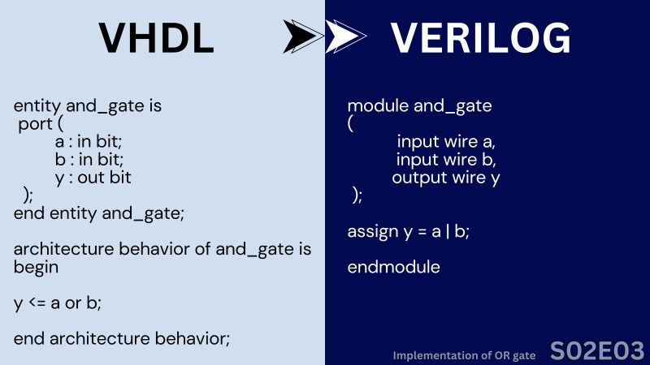

Slide 27
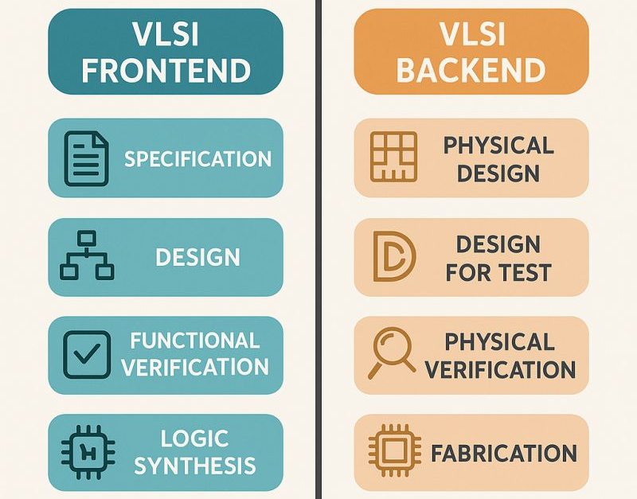
VLSI Career Roles:

Slide 28
THANK YOU!

